Slide 1
About The Kushi Institute

Slide 2
About the Kushi Institute
Founded by Michio and Aveline Kushi in 1978.
A division of the Kushi Foundation, Inc., a non-profit educational organization.
Dedicated to world health and peace through macrobiotic education.
Conducts residential educational programs at its facility in Western Massachusetts.

Slide 3
More on Kushi Institute
Largest macrobiotic educational facility in the world
Preserves original teaching of Michio Kushi as basis for macrobiotic health recommendations

Slide 4
The Way To Health Program
Weeklong residential program offered several times a month.
Attracts over 400 individuals annually (majority are cancer patients).
Involves lectures, cooking classes, individual counseling sessions and macrobiotic meals.

Slide 5
Macrobiotic Career Training
500 hours of study divided into 4 levels
Courses in diet, cooking, counseling, shiatsu massage and philosophy
Attracts over 100 students annually

Slide 6
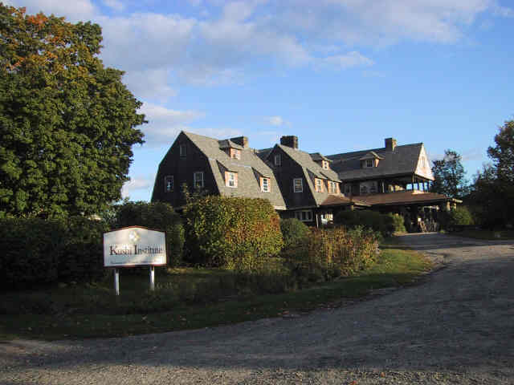
The Kushi Institute Main House
Located on 650 acres in Becket Massachusetts

