Slide 1
Click to begin

Slide 2
Food and Macrobiotics Part 1
Phiya Kushi
November 2012

Slide 3
“Let Food Be Thy Medicine And Medicine Thy Food”
- Hippocrates, The Father of Western Medicine
(b. 460BC)

Slide 4
Presentation Objectives
To examine the range of foods we eat and how we limit or expand our choices
To begin to understand the Yin/Yang logic behind food choices
To begin to understand the dynamics of healthy eating and the benefits and consequences of our food choices
To learn to eat in order to achieve our dreams

Slide 5
What do you think of when you compare a macrobiotic diet to what the average American eats?
?
?
?
Discussion Topic:
?
?
?
?
?
?
?
?
?
?
Notes:
Pause and ask the question of each participant. But first introduce yourself and your own story. Use the blackboard if necessary to remember important points from the audience.
Many people will say that they are here because of an illness. While it is fine that they here because of thier illness, they should be aware that they will not find a a quick solution to their problem but instead have come to a place where they asked to all aspects all their life, especially of the foods they have bene eating.
They can be reminded that their concerns will be addressed throughout the Seminar. They must also be reminded that their lives will be differrent from this point forward, and that after the Seminar is over, they can go back to living and eating their normal if they so choose yet if they do then they are really wasting their time and money here. That being the case then they should be allowed to commit once and for all to being in the Seminar from this point forward.

Slide 6
Do you think of the following?
That a macrobiotic diet is limiting?
That it involves the loss of some freedom?
That one may not get all the necessary nutrients on a macrobiotic diet?
That it will be bland?

Slide 7
Let’s take a closer look…

Slide 8
Do you recognize the following foods?…

Slide 9
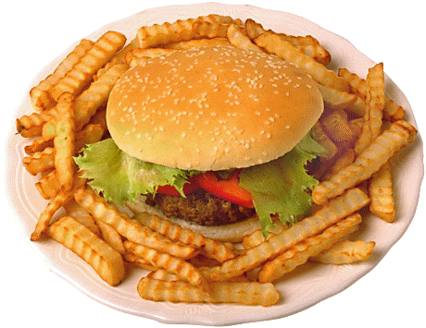
1. Hamburger and Fries

Slide 10
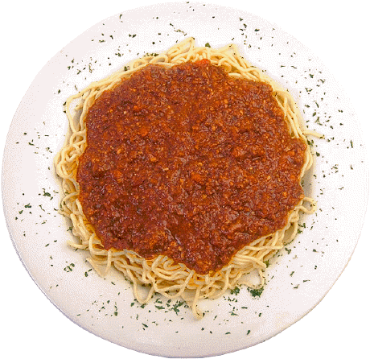
2. Spaghetti Bolognese

Slide 11
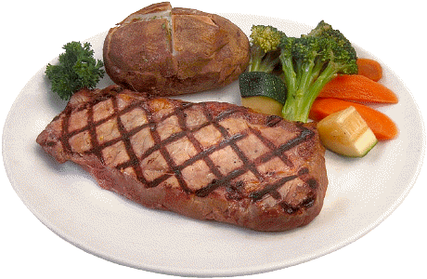
3. Steak Dinner

Slide 12
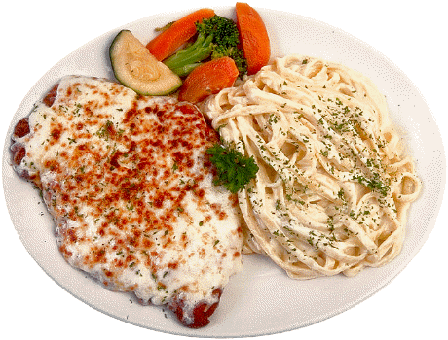
4. Fettuccine and Veal Parmesan

Slide 13
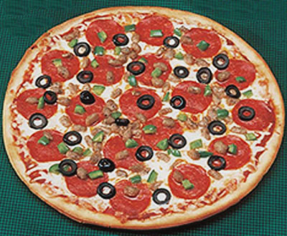
5. Pizza

Slide 14
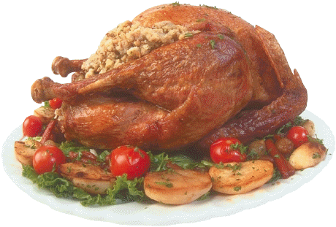
6. Stuffed Turkey

Slide 15
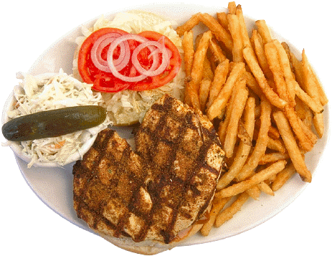
7. Barbequed Chicken

Slide 16
What are the key ingredients of these foods?
?
?
?
Discussion Topic:
?
?
?
?
?
?
?
?
?
?
Notes:
Pause and ask the question of each participant. But first introduce yourself and your own story. Use the blackboard if necessary to remember important points from the audience.
Many people will say that they are here because of an illness. While it is fine that they here because of thier illness, they should be aware that they will not find a a quick solution to their problem but instead have come to a place where they asked to all aspects all their life, especially of the foods they have bene eating.
They can be reminded that their concerns will be addressed throughout the Seminar. They must also be reminded that their lives will be differrent from this point forward, and that after the Seminar is over, they can go back to living and eating their normal if they so choose yet if they do then they are really wasting their time and money here. That being the case then they should be allowed to commit once and for all to being in the Seminar from this point forward.

Slide 17
Key Ingredients:
Meat (Steak, Beef, Chicken, Sausage, Turkey)
White Flour (Bread, Pasta, Stuffing)
Potato and/or Tomato (nightshades – plants that grow at night)
Dairy (butter, cheese, cream, milk)
Token vegetables (lettuce, onion, pickles)
Garnish; herbs and spices for flavoring

Slide 18
Let’s look again at those dishes…

Slide 19
Hamburger and Fries
1. Meat
2. White Flour
3. Potato and tomato
4. Cheese (not visible)
5. Token vegetables
6. Garnish

Slide 20
2. Spaghetti Bolognese
1. Meat
2. White Flour
3. Tomato
4. Cheese (not visible)
5. Token vegetables
6. Garnish

Slide 21
3. Steak Dinner
1. Meat
White Flour
(bread not shown)
3. Potato
4. Butter (not visible)
5. Token vegetables
6. Garnish

Slide 22
4. Fettuccine and Veal
1. Meat
2. White Flour
3. Tomato (in sauce)
4. Cheese
5. Token vegetables
6. Garnish

Slide 23
5. Pizza
1. Meat
2. White Flour
3. Tomato (in sauce)
4. Cheese
5. Token vegetables
6. Garnish

Slide 24
6. Turkey
1. Meat
2. White Flour (in stuffing)
3. Potato and tomato
4. Cheese (in stuffing)
5. Token vegetables
6. Garnish

Slide 25
7. Barbequed Chicken
1. Meat
2. White Flour
3. Potato (and tomato)
4. Cream
5. Token vegetables
6. Garnish

Slide 26
Now, compare this with typical macrobiotic fare…

Slide 27
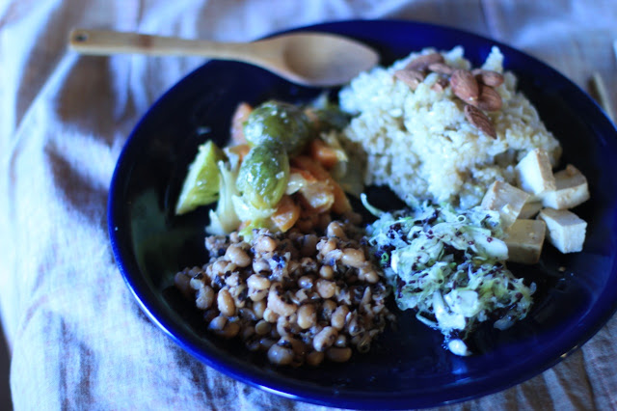

Slide 28
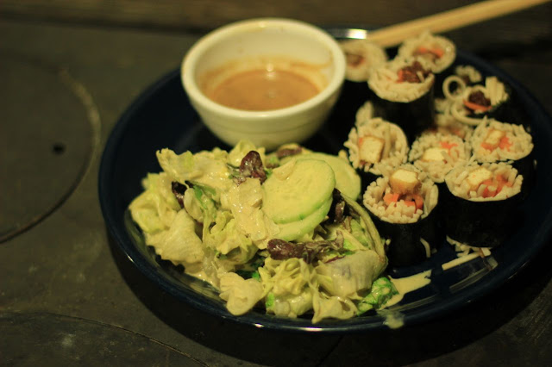

Slide 29
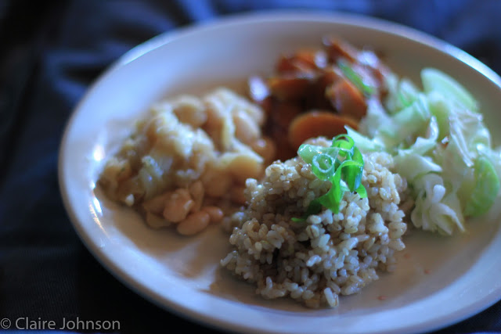

Slide 30
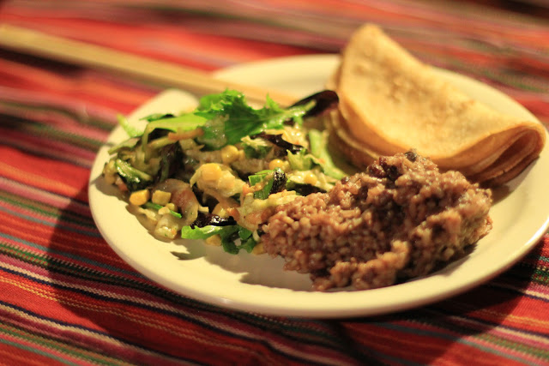

Slide 31
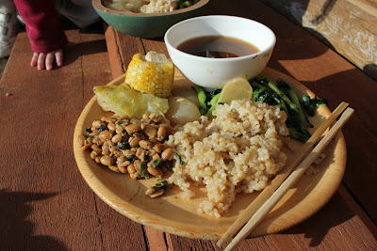

Slide 32
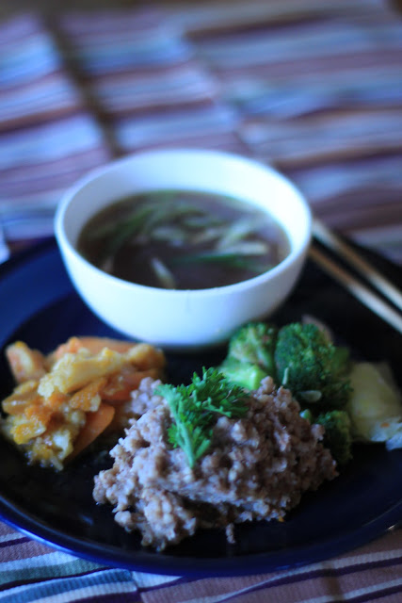
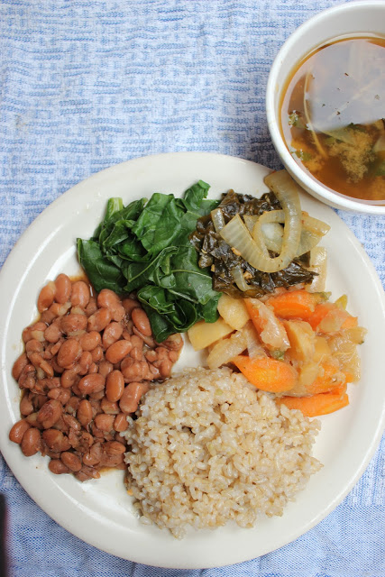

Slide 33
What are the key ingredients?
Whole grains (all kinds)
Beans and bean products (all kinds)
Vegetables (all kinds)
Sea Vegetables (all kinds)
Fermented foods
Fish and seafood
Soups

Slide 34
Even with the exclusion of meat, dairy and processed foods, a restrictive macrobiotic approach is at least as varied, if not more so.
Indeed, there are no limits to what you can eat macrobiotically. It is a matter of proportion, circumstance and personal choice. Macrobiotics is not about what you eat, but is about what happens when you eat.

Slide 35
Basic Dietary Variations according to need and lifestyle
Healing/mild – for recovering persons
Basic/Normal – for most people
Healthy/Active – for strong, healthy persons with an active lifestyle
Unhealthy – what most people eat today

Slide 36
Basic Yin/Yang Food Correlation
Yin = Foods that cause expansion
Yang = Foods that cause contraction
Salt, Animal
Whole Grains
Beans, Veggies
Sugar, Fruit
Yang
Yin

Slide 37
Yin/Yang correlation of Basic Dietary Variations
Healing/Mild
Range
Yang
Yin
2. Basic/Normal
Range
Yang
Yin
Notes:
The healing/mild dietary variation focuses on staying close to the middle of the spectrum. Dishes tend be more bland (unless well chewed) and flavors are derived without the use of any added stimulants, salt and other flavorings. By staying in the middle the body operates on a higher frequency because the extreme points are a shorter distance away from each other. Operating at a higher frequency enhances the spiritual and ascetic aspects of life. This type of eating is ideal for recovering from problems arising from extreme eating and living. Because the range is narrower, then subtleties such as eat too much (overeating) can have adverse effects.
The Basic/Normal variation is slightly wider, adding more polarity and adventure to life while maintaining a healthy balance.

Slide 38
Yin/Yang correlation of Basic Dietary Variations (cont’d)
3. Healthy/Active
Range
Yang
Yin
4. Unhealthy
Little or nothing in
the middle
Yang
Yin
Notes:
The Healthy/Active model allows for a wider range of eating and living fully. It can sometimes lead to temporary yet minor health problems such as colds, fevers and occasional digestive problems. These bouts with health issues help to strengthen the body’s regenerative abilities, as long as the person remembers to focus toward the center during recovery times.
The Unhealthy model relies too much on over stimulating foods and is no longer satisfied with “middle of the road” foods. The type of eating and living continually and consistently seeks stronger and more exciting tastes, flavors and experiences. It is the model of addictions, overdose, and bodily abuse. This can happen rapidly, depending on the extreme nature of the ingested substance or it happen slowly through sustained eating of extreme foods such as animal products and refined products.

Slide 39
Yin/Yang correlation of Basic Dietary Variations (Extreme)
Leading To Premature Death
Yang
Yin
Range
Notes:
Death is the result of going too far on either side

Slide 40
1. Healing/Mild Dietary Guidelines
Whole grains only (no refined and flour products)
Reduced salt
Little or no oil
No animal foods or products
Little or no raw foods
Little or no fruit
Beverages consist of only non-caffeine teas and water

Slide 41
2. Basic/Normal Dietary Guidelines
Whole grains daily with occasional whole grain flour products
Monitored salt intake
Oil as needed
Occasional fish and seafood (as desired)
Occasional raw foods
Occasional fruit
Beverages mostly consists of only non-caffeine teas and water

Slide 42
3. Healthy/Active Dietary Guidelines
Same as basic with some “wider” eating including (as desired, but not needed):
On social occasions: some animal products
On social occasions: refined products
On social occasions: beverages can include caffeine and alcohol

Slide 43
4. Unhealthy Dietary Guidelines
Heavy cooked animal products as the base
Mostly refined grains and flour products with little or no whole grains
Excessive Salt and Oil
Vegetables limited to mostly nightshades and prepared mostly raw or fried
Plenty of fruit, sugar, and desserts
Beverages consists mostly of soda, coffee and alcohol
Plus supplements, medications and drugs

Slide 44
Dietary Guidelines Summary
For serious health concerns seek guidance specific to your situation
For normal everyday concerns, eat primarily a plant based diet, with whole grains as the main staple.
For active lifestyles, eat a wider variety of foods.
Avoid eating extreme foods in general

