Slide 1
Understanding Yin and Yang
Phiya Kushi
November 2012

Slide 2
Yin and yang is the study of: CHANGE
Everything changes in the Universe

Slide 3
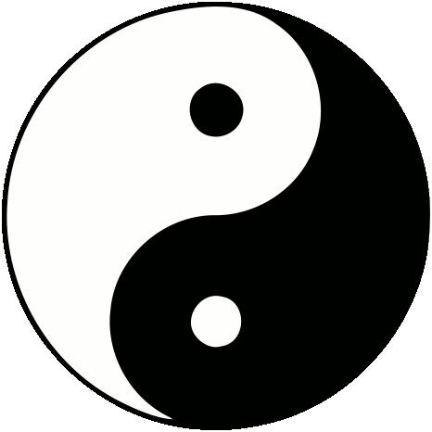
When we think of Yin and Yang normally we think of this:
But this is misleading

Slide 4
In reality we should think of this…

Slide 5
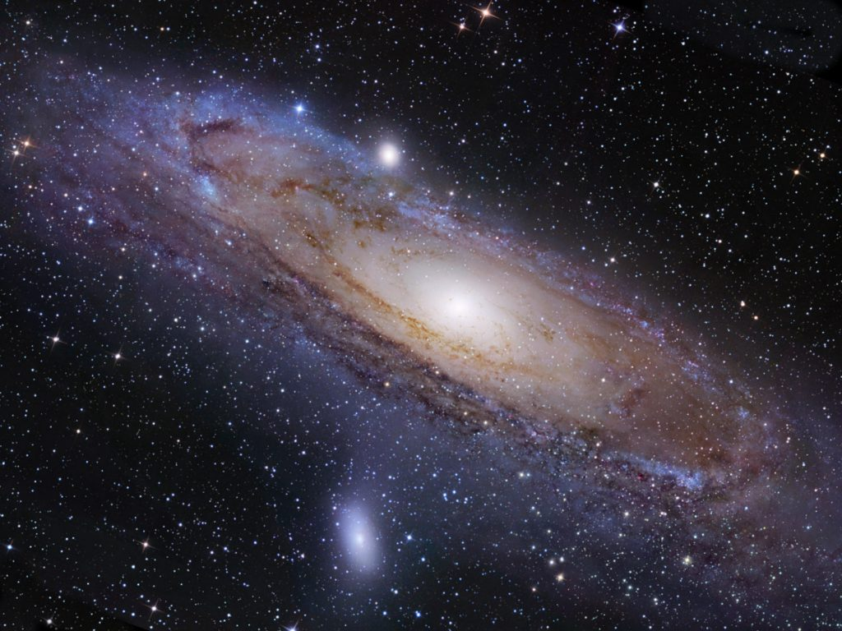

Slide 6
and this…

Slide 8
and this…

Slide 10
and this…

Slide 11
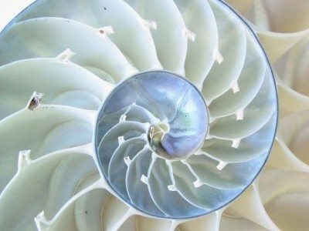

Slide 12
and this…

Slide 14
and this…

Slide 15
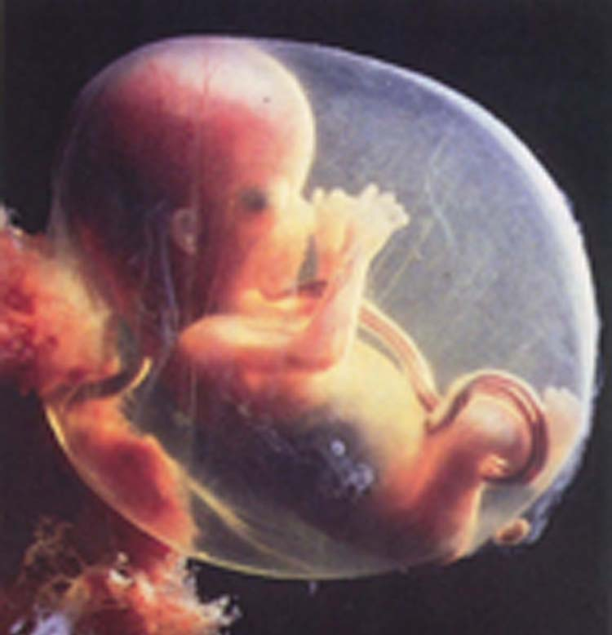

Slide 16
Yin and Yang are
Objective descriptors of our universe
Independent of the observer
The dynamic directional movements of the spiral
contracting=“yang”
expanding=“yin”
Always changing and moving.
At the extremes their motions turn into their opposites

Slide 17
Yin and Yang are NOT:
Subjective Linguistic Interpretations:
Good/Bad
Right/Wrong
Static states
Changeable depending on observer

Slide 18
NOT Yin and Yang:
Good vs. Evil

Slide 19
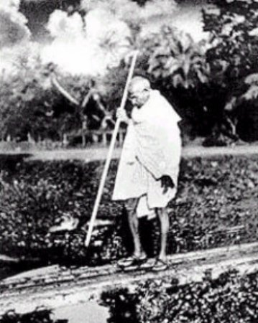
NOT Yin and Yang:
Right vs. Wrong

Slide 20
NOT Yin and Yang:
Love vs. Hate
Beauty vs. Ugly
Smart vs. Stupid
etc.
These are subjective, linguistic (or mind) based and depend on subjective circumstance

Slide 21
IS Yin and Yang:
Day and Night
Hot and Cold
Up and Down
Hard and Soft
Big and Small, etc.
These are objective, variable, and relative observations and are independent of subjective value and interpretation.

Slide 22
Yin and Yang is...
not how you think things are…
…but how they really are!

Slide 23
To understand Yin and Yang you must:
Be able to distinguish yourself (your mind) from reality. You must (un)learn who you are.
Your mind is full of concepts, judgments and memories that are human creations or culturally based.
Reality is without judgment.
To see reality you must see without judgment, bias and preference.

Slide 24
To understand Yin and Yang you must:
Understand who you are
Study how your mind works
Practice seeing, listening and experiencing reality as it really is
Learn to distinguish what are your thoughts from what is real.

Slide 25
Yin and Yang basics:
All phenomena are moving and changing according to Yin and Yang
All opposing phenomena are relative complementary opposites of one whole
Everything turns into its opposite eventually
Yin attracts Yang, Yang Attracts Yin
Yin repels yin, yang repels yang
At the extremes Yin changes in Yang and Yang changes into Yin
Nothing is exclusively Yin and nothing is exclusively Yang
Nothing is neutral, everything has yin or yang in excess in varying degrees
Nothing is identical. A thing is more yin or more yang relative to another thing.
All phenomena are yang at the core and yin at the periphery
All phenomena appear and disappear in shape of a spiral with fractal dimensions.

