Slide 1
What is Macrobiotics?
A Presentation by Phiya Kushi
Portions © 2004 Phiya Kushi

Slide 2
What is “macrobiotics”?
Have you heard the word before?
What does it mean?
Where did it come from?

Slide 3
Presentation Objectives
To introduce the ancient origins of macrobiotics
To give a basic overview of macrobiotic/health and diet references throughout history
To introduce the works of George Ohsawa and Michio Kushi
To learn of the influence of macrobiotics on modern history
To introduce macrobiotics as the basis of world peace

Slide 4
Macrobiotics is NOT:
A cult
A religion
Esoteric mysticism
Mind - Body Healing
Alternative Medicine
Only a diet

Slide 5
“Macrobiotics” has an image problem…

Slide 6
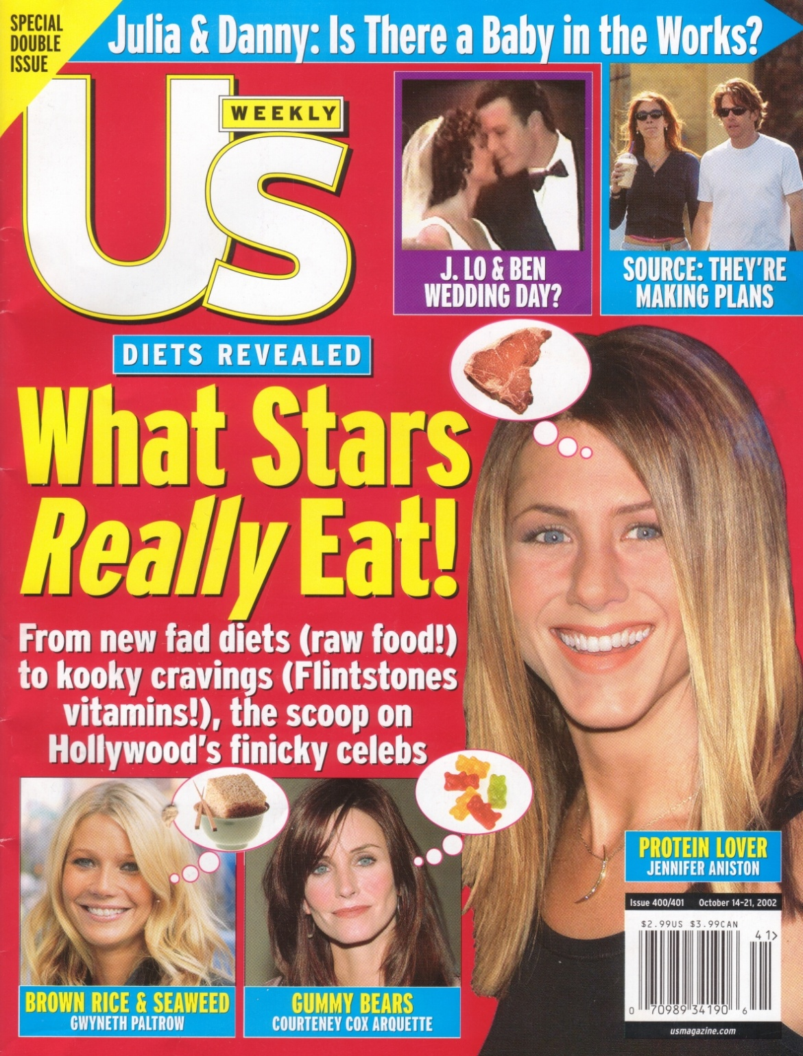
US Weekly
October 12, 2002

Slide 7
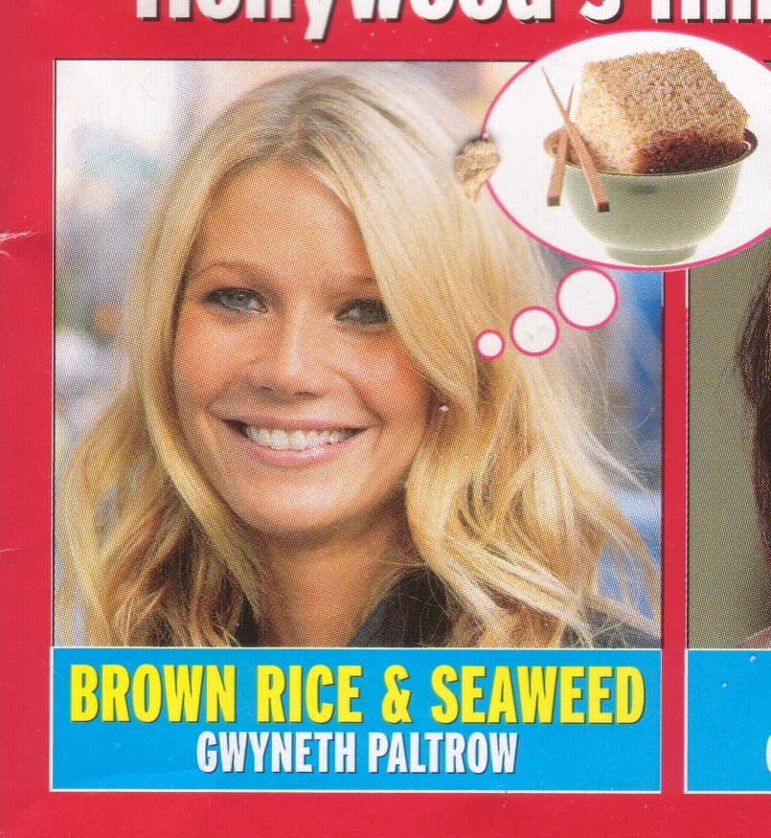

Slide 8
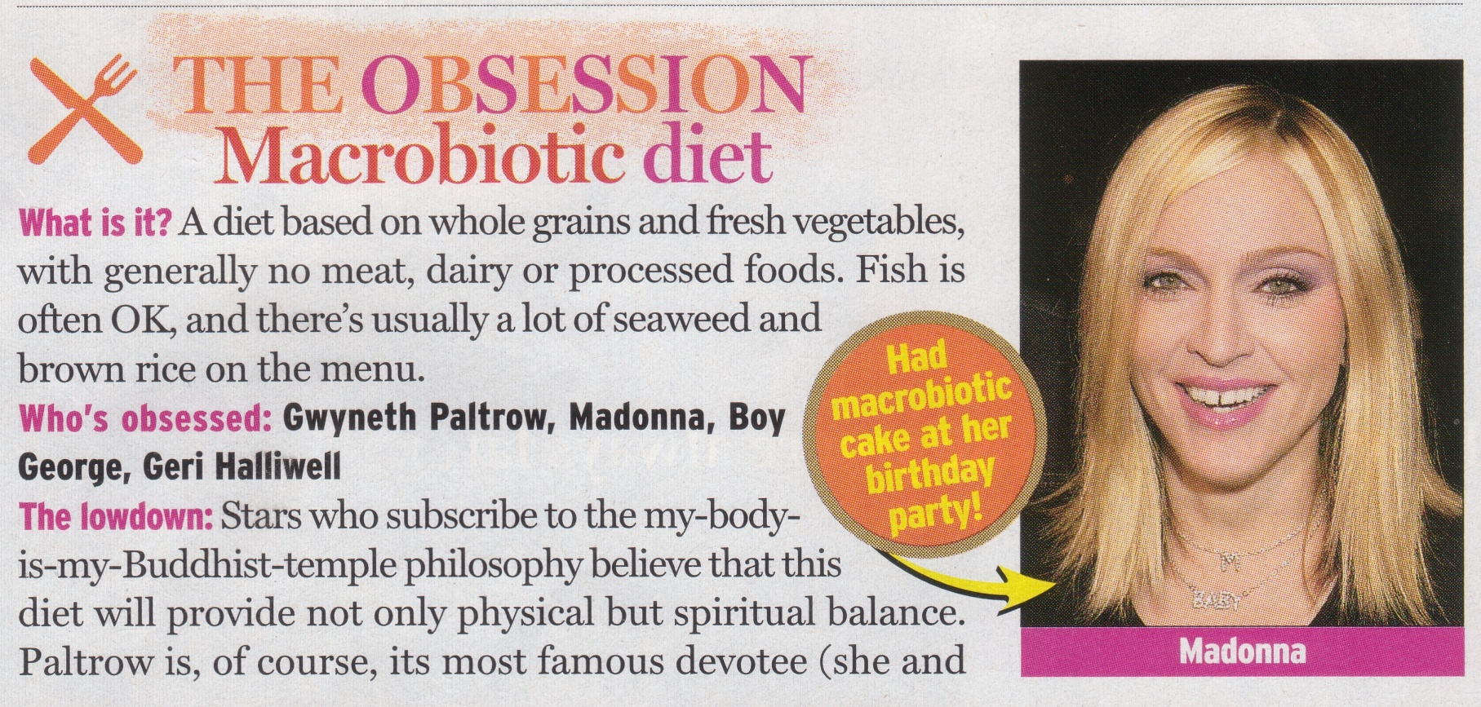
An Obsessive Diet

Slide 9
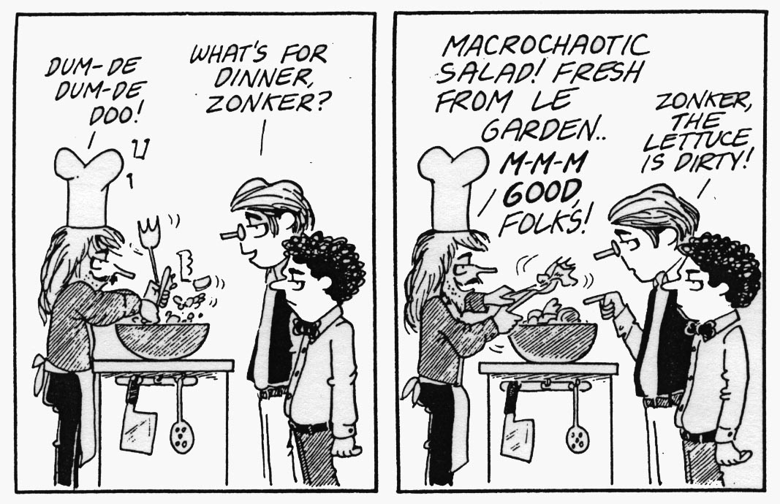

Slide 10
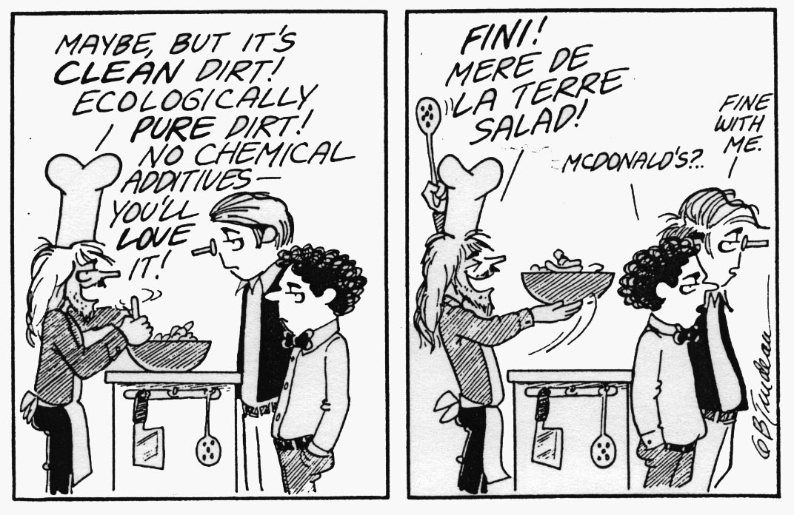

Slide 11
The “Macrobiotic” image problem:
Was thought of as a dangerous fad diet
Was thought of as a cult
Was thought of as eastern mysticism
At best, is a narrow diet based on Chinese philosophy that may be good for cancer

Slide 12
How “macrobiotics” is sometimes defined:

Slide 13
Main Entry: mac·ro·bi·ot·ic Pronunciation: -bI-'ä-tik, -bE- Function: adjective Date: 1965
: of, relating to, or being a diet based on the Chinese cosmological principles of yin and yang that in its most rigorous forms consists primarily of whole grains and requires caution to avoid malnutrition, scurvy, or anemia
- Merriam Webster Online Dictionary

Slide 14
The Official Kushi Institute Definition for “Macrobiotics”:
Macrobiotics is the art and science of
health and longevity through the study
and understanding of the relation and
interactions between ourselves, the foods
we eat, the lifestyles we choose to lead,
and the environments in which we live.
(See WEB Site: www.macrobiotics.org for more description…)

Slide 15
A new definition…

Slide 16
Macrobiotics is:
Macro-biology is the study of our lives and the dynamic relationship that we have between ourselves and our universe including the foods we eat, the lifestyles we lead and the environments in which we live.
Macrobiotics is the practice of applying life lessons learned through Macro-biology and involves ongoing self-reflection and objective exploration of the changing dynamic universe in which we live.

Slide 17
The Purpose of Macrobiotics
The purpose of Macrobiotics, as a daily life practice, includes improved well-being, longevity, happiness, peace and harmony with the natural environment.

Slide 18
The History of Macrobiotics Phiya Kushi November 2012

Slide 19
Hippocrates
The Father of Western Medicine
(b. 460BC)

Slide 20
Hippocrates (b. 460BC) The Father of Western Medicine
“Macro-bios” – “Long Life” The term originates from Hippocrates, “Ho bios brachys, he techre machre” (Life is short, but the art is long)
Also is attributed to coining the phrase – “Let Food Be Thy Medicine and Medicine Thy Food”
Original Hippocratic Oath: “I will apply dietetic measures for the benefit of the sick … I will neither give a deadly drug…I will not use the knife…” – (see “Ancient Medicine” by Ludwig Edelstein, Johns Hopkins University Press)

Slide 21
However, long before Hippocrates invented the word…

Slide 22
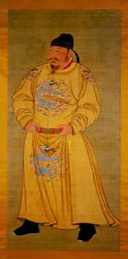
(Huang Di) The Yellow Emperor
~ 4,000 BC

Slide 23
Yellow Emperor’s Classic of Medicine (Nei-Ching) ~ 3,000 BC (5,000 years ago)
Promoted the notion of balance and living and eating in harmony with the natural environment - “People and nature are inseparable”
Explains uses of Yin/Yang classification in healing, disease and remedies
Presents energetic view (meridians and Ki energy) of the body for assessment and treatment
Is based on earlier works and discoveries of ancient China
(book available through the Kushi Store)

Slide 24
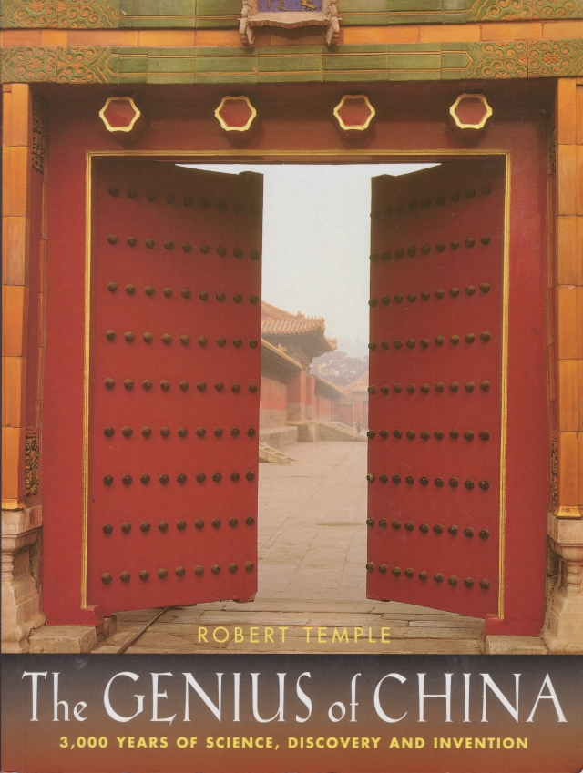
The Genius Of Ancient China
Throughout Chinese history, Chinese healers emphasized dietary recommendations over any other form of medicine.
For more information on the history and advances of Chinese Science and Medicine please read “The Genius of China” by Robert Temple.
“Many diseases can be cured by diet alone.”
-Hu Ssu Hui – Imperial Dietician 1330AD
(from “The Genius of China” by Robert Temple)

Slide 25
Also, in the East was…

Slide 26
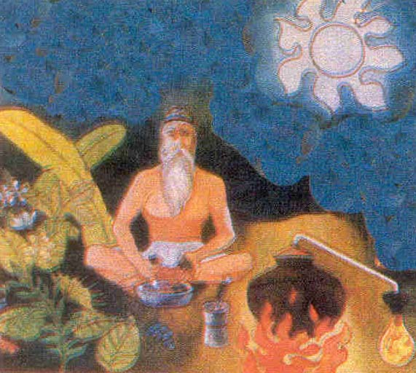
Caraka Samhita~ 1,500 BC
“Caraka Samhita” –(~1,500 BC), Hindu Ayuvedic extensive medical text with Hindu dietary codes - author unknown

Slide 27
Hippocrates also had many contemporaries whom also promoted proper eating…

Slide 28
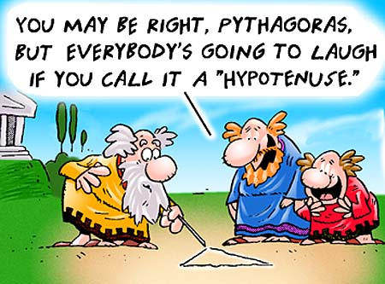
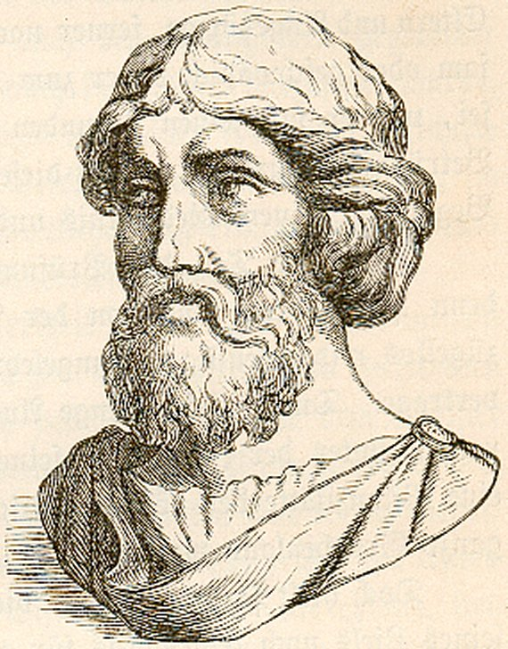
Pythagoras Ethical Vegetarian 570 ~ 490 BC

Slide 29
Pythagoras (580-500 BC?)
In addition to mathematics, promoted vegetarianism.
Recommended simple eating and living to stay healthy.
“DO NOT NEGLECT THE HEALTH OF THE BODY, KEEPING MEASURE IN EATING AND DRINKING, AND EVERY EXERCISE OF THE BODY, AND BY MEASURE IS MEANT WHAT WILL NOT LATER INDUCE PAIN.”

Slide 30
And before Hippocrates in the Middle East…

Slide 31
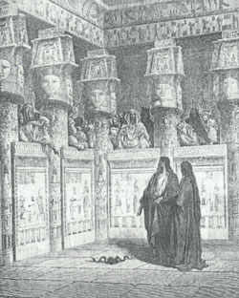
Biblical Dietary References ~ 2,000 years ago
Kashruth
(Kosher Dietary Laws)
The Lord instructs Moses and Aaron on what are clean and un-clean foods to eat
- see Leviticus 11
Moses and Aaron in Egypt

Slide 32
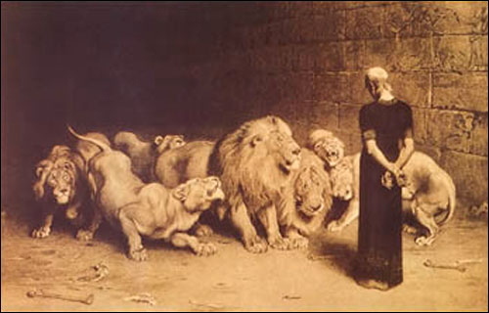
Biblical Dietary References ~ 2,000 years ago
Book of Daniel 1.12-13
12 "Please test your servants for ten days, and let us be given some vegetables to eat and water to drink.
13 "Then let our appearance be observed in your presence and the appearance of the youths who are eating the king's choice food; and deal with your servants according to what you see."
Daniel in the lion’s den

Slide 33
The Original Greek Orthodox Bible uses the “macrobiotic” word (in Greek, of course)

Slide 34
Later on, after Bible times in the West…

Slide 35
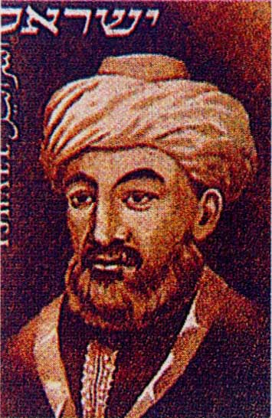
Maimonedes (Rabbi Moses Ben Maimon) (1135-1204)

Slide 36
Maimonedes (Rabbi Moses Ben Maimon) (1135-1204)
Famous Jewish philosopher, physician and jurist, born in Spain.
Known for promoting a “golden path” of moderation or balance in everything in order to stay healthy: “Shveel Hazahaz”

Slide 37
Luigi Cornaro (1464-1566)
Lived to the age of 102 after discovering the health benefits of a moderation
Carefully measured his food intake to 14 ounces per day and he noticed a drastic decline in his health when he increased this to 16 ounces
Wrote a series of discourses entitled “La Vita Sobria” (or the “Art of Living Long”) when he was at the ages of 83, 86, 91 and 95

Slide 38
And in the Far East…

Slide 39
Eikken Kaibara (1630-1716)
Wrote book “Secrets of Good Health” combining philosophy and practical living for longevity
Suggested that the natural state of humanity is to be healthy
Recommended proper diet along with many other basic lifestyle suggestions

Slide 40
Namboku Mizuno (1757-1825)
Wrote book “Namboku Method of Physiognomy” which connected physiognomy with personality and dietary patterns
A soothsayer told him he had only two years to live and suggested he live an ascetic life as a monk
After being accepted to work in temple he changed his destiny by following simple diet of grains and vegetables
Devoted his entire life afterward to study the human body by becoming a barber, a masseur, and working in a crematorium.
Determined that “Food Governs Your Destiny”

Slide 41
And in the West…

Slide 42
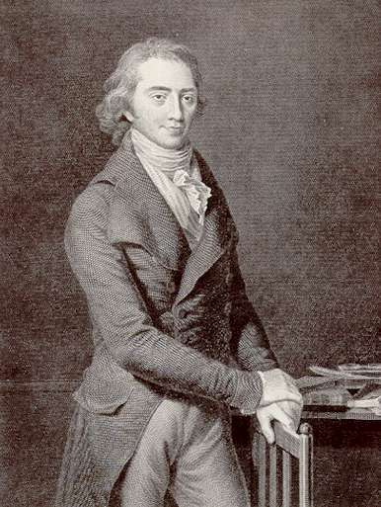
Dr. Christoph Wilhelm Hufeland (1762-1836)

Slide 43
Dr. Christoph Wilhelm Hufeland
Was Physician to The King of Prussia, German philosopher/poet Goethe and philosopher, Schiller
Published book in the 1780s in German Makrobiotik: Die Kunst das Mensliche Leben zu Verlängern (Macrobiotic: The Art of Prolonging Human Life)
Cites other persons before him whom credits proper diet with longevity including Count Luigi Coronaro

Slide 44
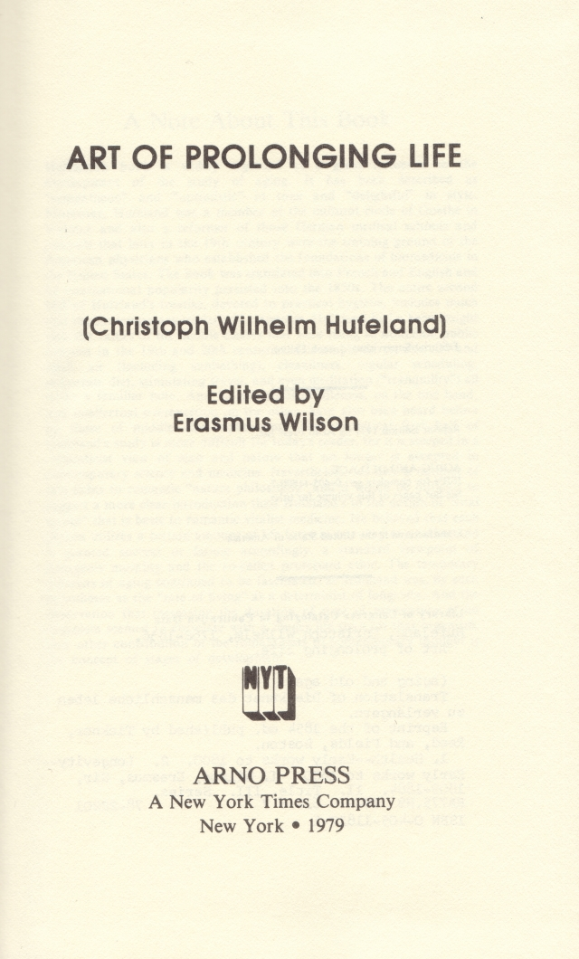
Originally translated from German into English in 1797

Slide 45
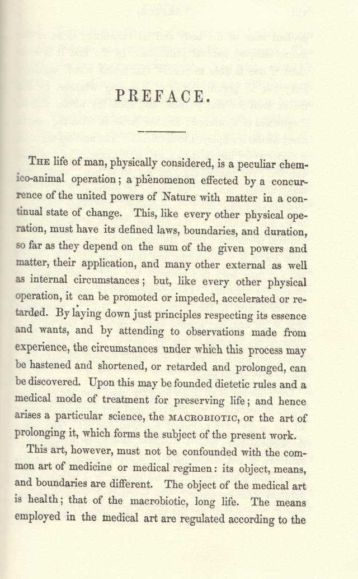
… “Upon this may be founded dietetic rules and a medical mode of treatment for preserving life; and hence arises a particular science, the MACRO-BIOTIC, or the art of prolonging it, which forms the subject of the present work.”
- Christoph W. Hufeland 1797

Slide 46
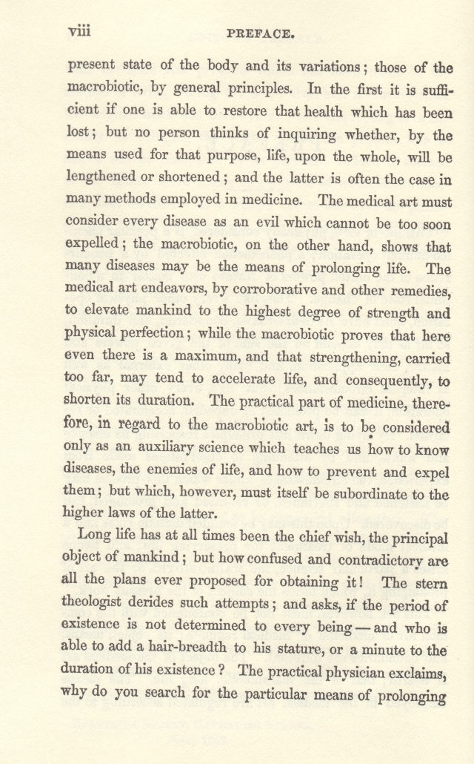
“The medical art must consider every disease as an evil which cannot be too soon expelled; the macrobiotic, on the other hand, shows that many diseases may be the means of prolonging life.”
- Hufeland 1797

Slide 47
Horace Fletcher (1849-1919): The Chew-Chew Man
In 1898 he discovered the benefits of chewing when he experimented on chewing every bite of food and lost 60 pounds in six months.
Wrote “The ABC of Nutrition” in 1903
“I choose to chew, Because I wish to do, The sort of thing that nature had in view, Before cooks invented savr’y stew, When the only way to eat was to chew! Chew! Chew!”

Slide 48
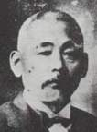
The present day lineage of Japanese macrobiotics begins with Dr. Sagen Ishizuka (1850-1910)

Slide 49
Dr. Sagen Ishizuka (1850-1910)
Promoted traditional foods as remedy for most illnesses
Known as “Dr. Anti-Doctor” for going against the advice “modern” Doctors
Introduced the idea of Na/K balance in diet
Created the Cure by Food Society (Shoku Yo Kai)
His teachings Georges Ohsawa recover from tuberculoisis

Slide 50
Meditation on Food and Destiny
The foundation of the world is the nation
The foundation of nation is the home
The foundation of the home is the body
The foundation of the body is the spirit
The foundation of spirit is food
- Dr. Sagen Ishizuka

Slide 51
The Westernization of Japan:
The beginning of one world

Slide 52
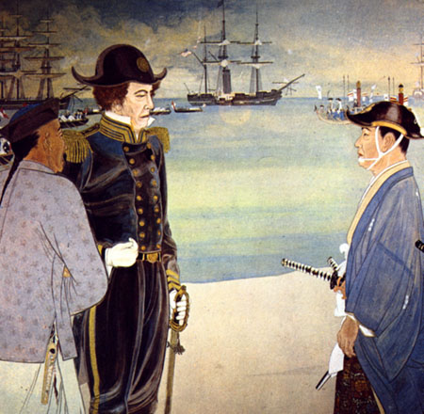
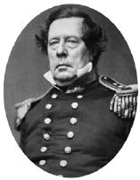
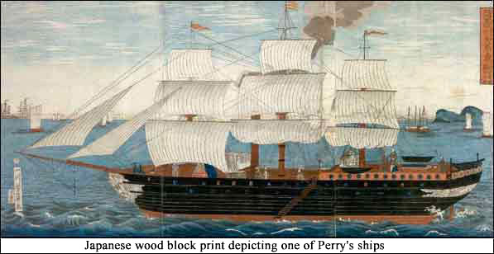
Commodore Perry In Japan 1854

Slide 53
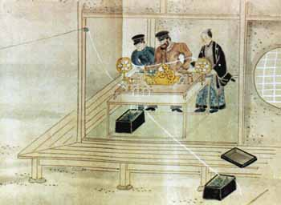
Commodore Perry demonstrates morse code

Slide 54
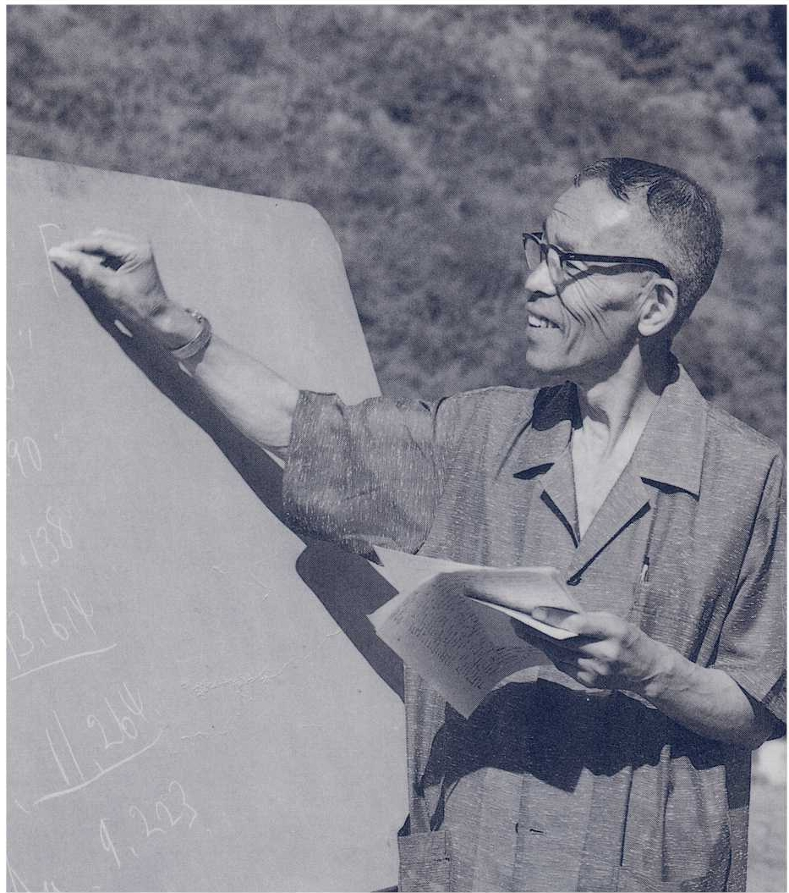
George Ohsawa: free spirited thinker, inventor, exporter of oriental ideas and unifier of East and West
George Ohsawa in California in 1960s

Slide 55
George Ohsawa (pen name)
Born 1893 – died 1966 Nyoiti Sakurazawa
Published over 300 books in Japanese, French and English all relating to macrobiotics and introducing the philosophy of the far east
Discovered “macrobiotics” and the power of food when he contracted tuberculosis
Followed Dr. Sagen Ishizuka ( a/k/a Dr. Daikon or Dr. Miso Soup) teachings that suggested a return to traditional foods of Japan as a remedy for most health issues. Ishizuka created the “Cure by Food Society” of which Ohsawa later became president.

Slide 56
More on George Ohsawa
Being direct witness to the Westernization of Japan (Meiji Restoration Era – Post Commodore Perry’s Gunboat Diplomacy) and the adoption of western foods and medicine and their detrimental effects, Ohsawa, adopted his teacher’s, Dr. Ishizuka, position and encouraged a return to the traditional philosophies and practices of Japan.

Slide 57
More Ohsawa
Promoted the notion that world peace could only be established through the marriage of East and West where the technical and analytical advances of the west (yang approach to life) would be guided by the aesthetic and more contemplated orientation of the east (yin approach to life).

Slide 58
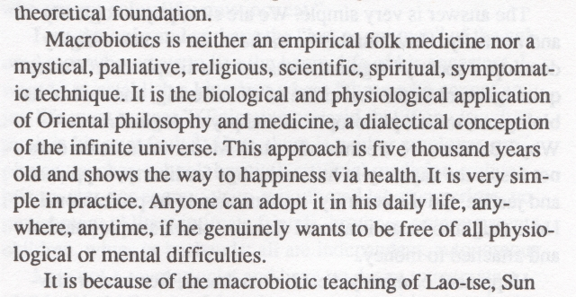
George Ohsawa – 1960 “Zen Macrobiotics”
Ohsawa’s intellectual and wordy description of macrobiotics

Slide 59
Ohsawa’s 7 Indications Of Health
----------Physical-(15pts Total)----------
Good Appetite (5pts)
No Fatigue (5pts)
Good Sleep (5pts)
-----------Mental-(30pts Total)----------
Good Memory (10pts)
Quick in Thought and Decisions (10pts)
Good Humor (10pts)
------Can You Guess What #7 Is?------
7. Never Lie (55pts)

Slide 60
Some dialectical Yin/Yang thoughts from Ohsawa:
Freedom is to be found only in slavery
Starlight is to be seen only on a dark night
Wise men are not to be found in a wise country
Millionaires are not millionaires in a country of millionaires
There can be no front without a back, good without evil, beauty without ugliness
from “Philosophy of the Far East and Oriental Medicine”, 1956, G. Ohsawa

Slide 61
George Ohsawa’s Students
Michio and Aveline Kushi
Herman and Cornellia Aihara
Alcan Yamaguchi
Francois Riveire
Rene Levy
Many more…

Slide 62
A1955 in New York City
L-R: Alcan Yamaguchi, (baby Norio), Michio, (child Lily), Aveline, Cornellia, and Herman Aihara

Slide 63
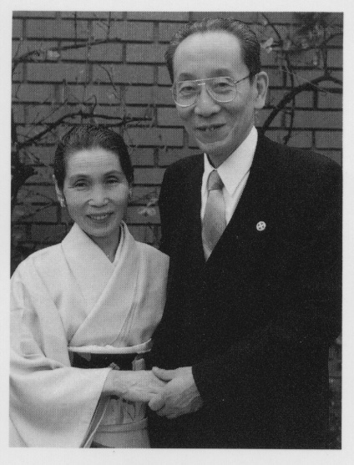
Michio and Aveline Kushi c. 1988
Michio and Aveline
Ambassadors Of Eastern Thought and Culture
World Peace activists
Pioneers
Entrepreneurs
Scholars
Unifiers of all branches of thought and science through education and macrobiotics

Slide 64
Michio Kushi, early years
Born in Japan in 1926 to parents who were educators
Finished in the top tenth percentile in the country for college entrance exams
Studied Political Science at Tokyo University
Became committed to the cause of world peace as a result of World War II

Slide 65
Michio comes to the US
Joined World Federalist movement after World War II
Met George Ohsawa and was introduced to the notion of diet and peace
Came to USA in 1949 under sponsorship from Norman Cousins, Vice-President of the World Federalists movement.
Pursued World Government studies at Columbia University

Slide 66
Michio in the US, self study
Meets with World Federalists leaders (including Einstein) and asks how we can prevent human aggression.
With no leader/thinker able to answer such a question, Michio leaves Columbia and pursues his self study of humanity

Slide 67
Michio promotes macrobiotics
Michio concludes that diet is the key to human destiny and world peace and begins to actively spread macrobiotics
Moves to Boston to teach at Harvard
Disappointed with the lack of interest from Harvard undergraduates, Michio begins teaching out his home to hippies

Slide 68
Michio and Aveline, Natural Foods, Oriental Medicine, etc.
Michio lectures, Aveline teaches Cooking Classes and introduce natural foods
Create “Erewhon Natural Foods” the first company of its kind
Creates East West Journal
Conducts seminars on Oriental Medicine and Philosophy to Doctors and lay people

Slide 69
Michio Educational Development
Establishes the Kushi Institute in 1978
Begins teaching worldwide
Introduces Cancer and Diet correlation
Writes books
Continues to this day…

Slide 70
Michio and Aveline’s Students
William Tara
Verne Verona
Denny Waxman
Edward Esko
Alex Jack
Many, many, many more…

Slide 71
End of Presentation www.phiyakushi.com phiyak@gmail.com Facebook.com/Phiya phiyakushi.wordpress.com kushipublishing.com

